Slide 1
Analysis of different methods to approach and solve Hidden Markov Models.
By: Prayag Jain (170001037)
Yasasvi V Peruvemba (170002061)

Slide 2
Contents
Hidden Markov Models
Forward Backward Algorithm
Time Complexity Analysis
Viterbi Algorithm
Time Complexity Analysis
CarpeDiem Algorithm
Time Complexity Analysis

Slide 3
Hidden Markov Model

Slide 4
Definition
Hidden Markov Model (HMM) is a statistical Markov model in which the system being modeled is assumed to be a Markov process with unobserved (i.e. hidden) states.
Hidden Markov models are especially known for their application in reinforcement learning and temporal pattern recognition such as speech, handwriting, gesture recognition, part-of-speech tagging, musical score following, partial discharges and bioinformatics.

Slide 5
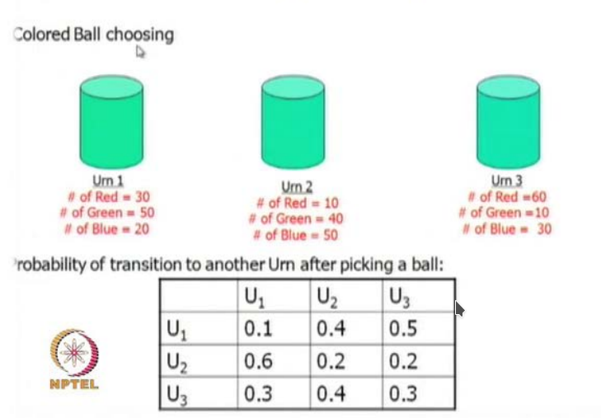
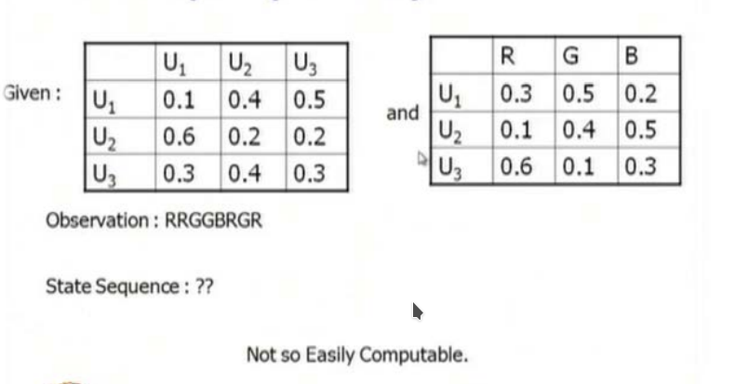
A Motivating Example

Slide 6
Forward & Backward Algorithm

Slide 7
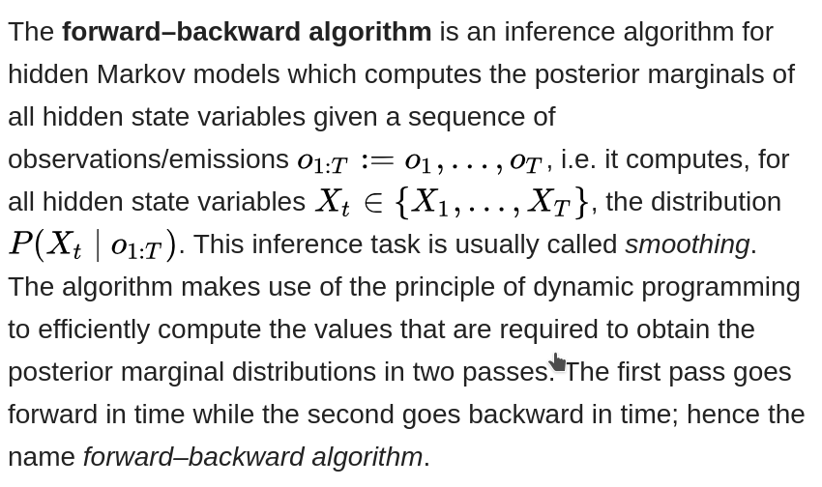
Definition

Slide 8
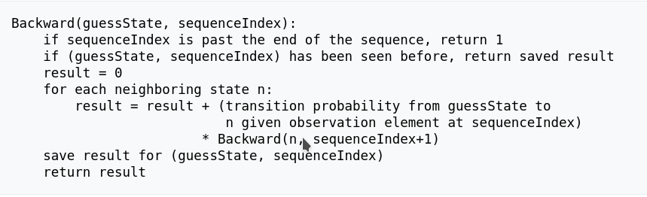
Pseudocode
Forward Backward C++ Implementation

Slide 9
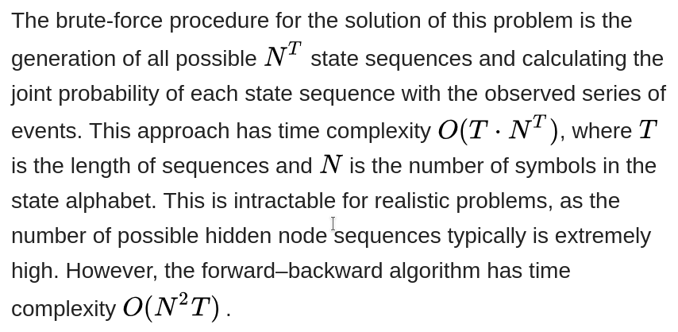
Time
Complexity

Slide 10
Viterbi Algorithm

Slide 11
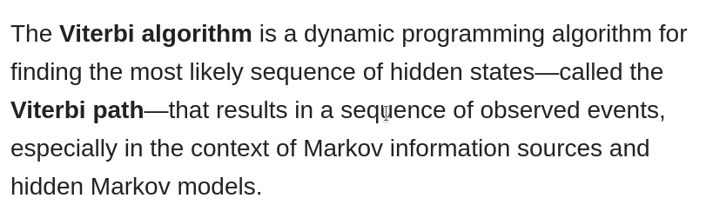
Definition

Slide 12
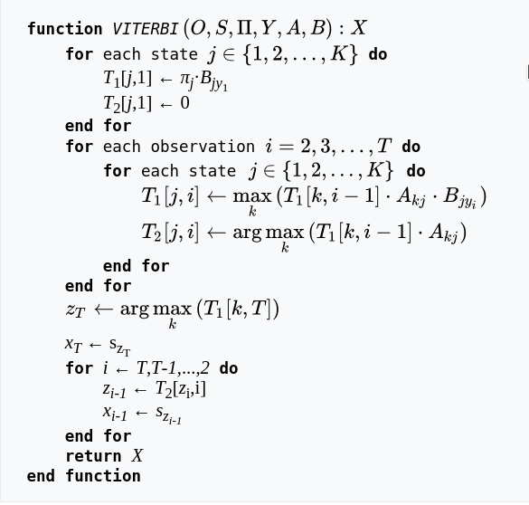
Pseudocode
Viterbi C++ Implementation

Slide 13
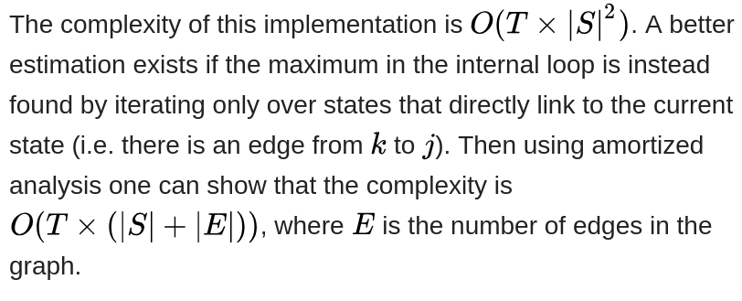
Time
Complexity

Slide 14
CarpeDiem Algorithm

Slide 15
Definition
In order to determine the end point of the best path to a given layer, one can avoid inspecting all vertices in that layer. In particular, after sorting the vertices in layer t according to their vertical weight, the search can be stopped when the difference in vertical weight of the best node so far and the next vertex in the ordering is big enough to counterbalance any advantage that can be possibly derived from exploiting a better transition and/or a better ancestor

Slide 16
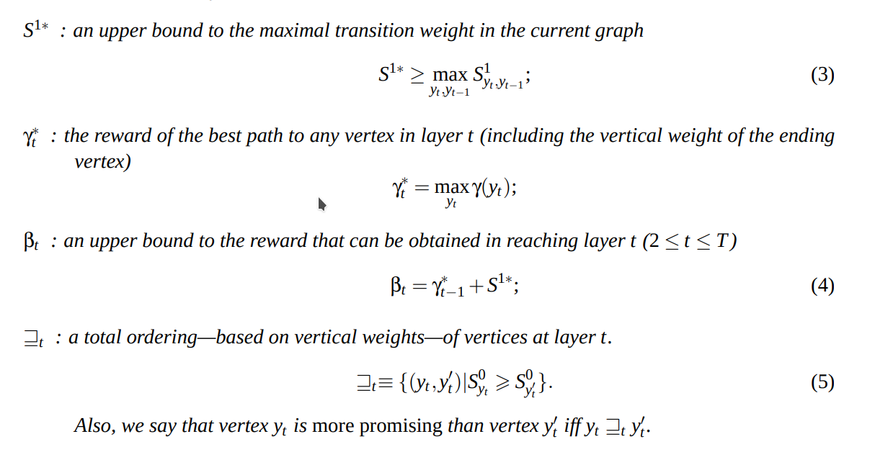
Lets Define

Slide 17
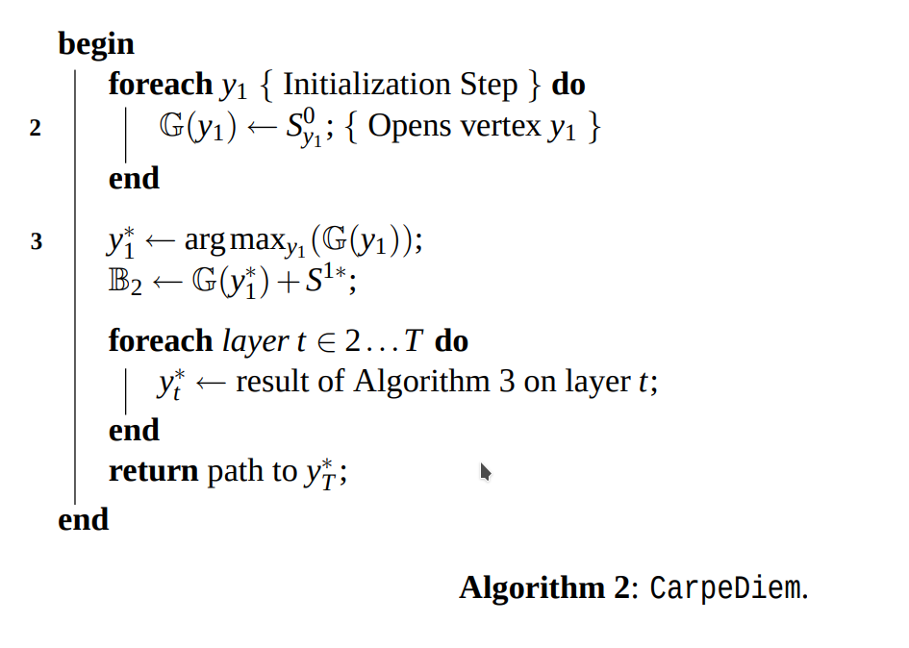
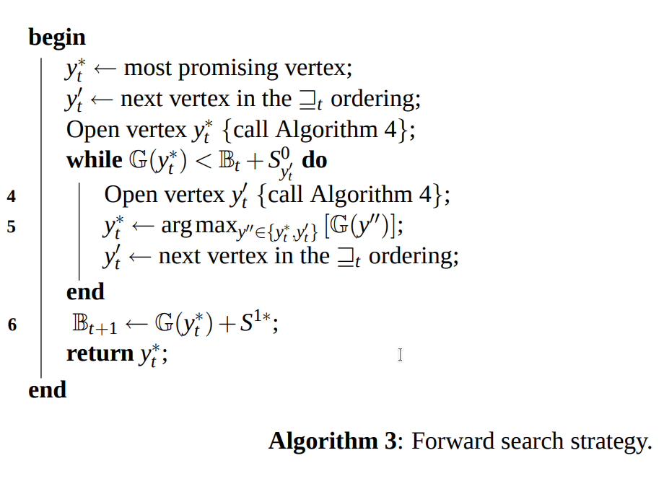
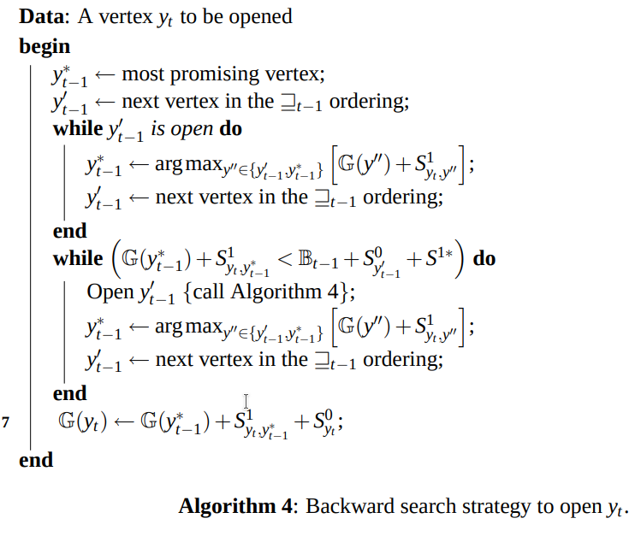
Pseudocode

Slide 18
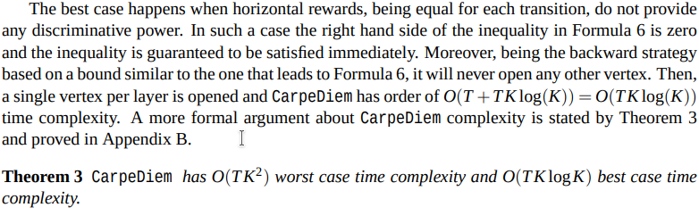
￼
￼
Time
Complexity

Slide 19
Thank You!!

